Slide 1
CRIME RECORD MANAGEMENT SYSTEM GROUP 1

Slide 2
MEMBERS
Lordwell Manondo bed-com-26-18
Chifuniro Masula bed-com-19-18
Molece Nkhoma esc-37-16
Yamikani Chabuka bed-com-42-18
William Chikaoneka bed-com-22-18

Slide 3
PROBLEM STATEMENT
It is obviously believed that the police force is charged with the responsibility of protecting lives, property and assuring safety and well-being of all citizens through the detection and apprehension of criminals, prevention and control of crime. Nevertheless, there are still some shortcomings: Poor criminal record keeping in short and long-term bases which makes the processing difficult. Delayed feedback on the investigated crime cases. High cost of saving crime data as it is mostly associated with paperwork. Frequent cases of missing files/documents because records are not properly secure.

Slide 4
Focus
To design and develop a website that will help to improve the efficiency and effectiveness of the police security measures in keeping criminal records and assign the necessary police officer to investigate the crime and provide a report in time and at low cost.

Slide 5
Functional requirements
System should be able to do the following
Case management
. Registration
. Storage . Retrieval
Cases analysis
. Filtering and Customization
. Reports Generation

Slide 6
Non functional requirements
System should be
Effective
Efficient
Secure
User friendly

Slide 7
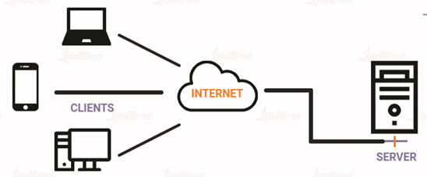
System architecture(client-server)
Officer
Public user
Admin

Slide 8
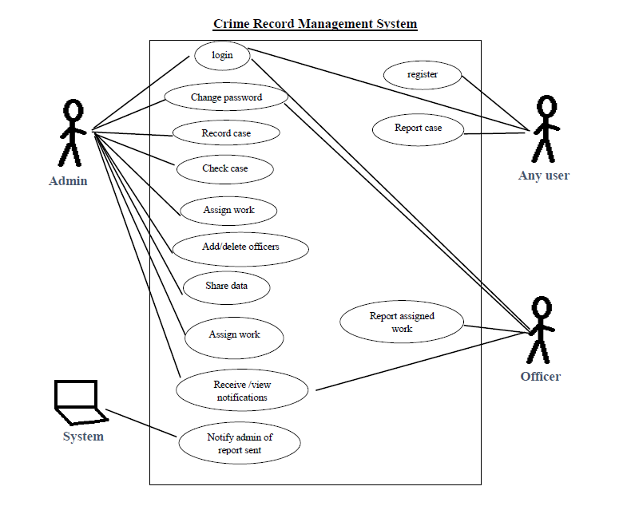
Use case
<<
>>

Slide 9
DEVELOPMENT TOOLS
Figma for prototype
MySQL Database
Bootstrap framework
CSS and HTML
PHP for backend

Slide 10
SYSTEM DEMONSTRATION

